Slide 1
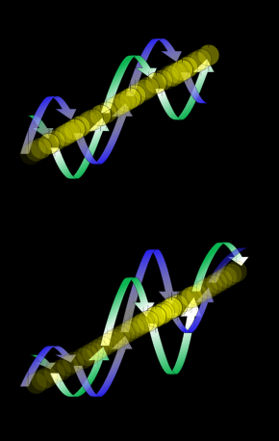
DE-BROGLIE WAVE

Slide 2
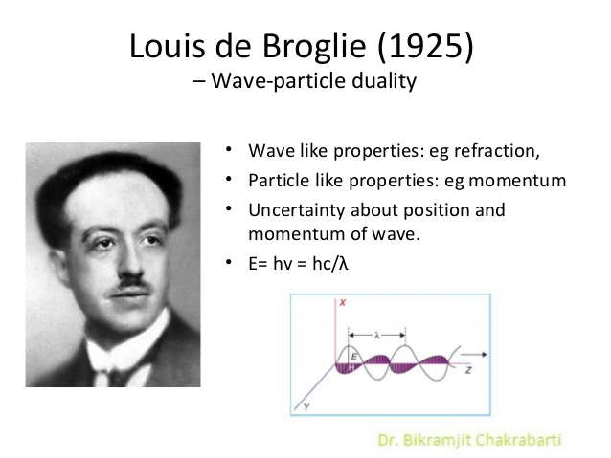
In 1924 Luis de-Broglie proposed that matter possesses wave as well as particle properties. This wave is called de-Broglie wave.

Slide 3

A photon of light of frequency $ν$ has the momentum
$$p=\frac{hν}{c}$$
$$p=\frac{hν}{νλ}$$
$$∴ p=\frac{h}{λ}$$
The wavelength of a photon is therefore specified by the relation
$$λ=\frac{h}{p} (1)$$
This wavelength is called de-Broglie wavelength.
de-Broglie suggested that equation (1) is completely general one that applies to material particle as well as photons.

Slide 4


The momentum of a particle of mass m and velocity v is given by$p=mv$
and its de-Broglie wavelength is accordingly
$λ=\frac{h}{mv} (2)$
Thus, the greater the particle’s momentum, the shorter its wavelength.
We know, $E=\frac{1}{2}mv^{2}$
or, $v=\sqrt{\frac{2E}{m}}$
Again, we know $λ=\frac{h}{mv}$
or, $λ=\frac{h}{m\sqrt{\frac{2E}{m}}}$
This is the expression for the Broglie wavelength in terms of energy.
$$λ=\frac{h}{\sqrt{2mE}}$$

Slide 5
WAVE VELOCITY AND GROUP VELOCITY

Slide 6

The equation of plane progressive wave is given by
$$y=a\sin{\frac{2π}{λ}\left(vt−x\right)}$$
$$y=a\sin{2π\left(\frac{t}{T}−\frac{x}{λ}\right)}$$
$$y=a\sin\left(ωt−kx\right)$$
$$Where ω=\frac{2π}{T}=2πn$$
$and k=\frac{2π}{λ}$
Here $ω$ is called the angular frequency of the wave and k is called the wave vector.
$$Again, \frac{ω}{k}=\frac{2πn}{\frac{2π}{λ}}=nλ=v_{p}$$
Here $v_{p}$ is called the phase/wave velocity. In other words, $v_{p}=\frac{ω}{k}$ is the velocity with which a plane progressive wave front travels forward. It has a constant phase $=\left(ωt−kx\right)$
$ωt−kx=constant$

Slide 7

Differentiating this equation with respect to t,
$$ω−k\frac{dx}{dt}=0$$
$$or \frac{dx}{dt}=\frac{ω}{k}=v_{p}$$
The phase/wave velocity of a wave is the rate at which the phase of the wave propagates in space. This is the velocity at which the phase of any one frequency component of the wave travels. $v_{p}=\frac{ω}{k}$
The group velocity of a wave is the velocity with which the overall shape of the waves' amplitudes-known as the modulation or envelope of the wave-propagates through space.
The group velocity v_{g} is defined by the equation:
$$v_{g}=\frac{dω}{dk}$$
where ω is the wave's angular frequency (usually expressed in radians per second), and k is the angular wave number (usually expressed in radians per meter).

Slide 8
RELATION BETWEEN WAVE AND GROUP VELOCITY

Slide 9

Let us consider that the wave group arises from the combination of two waves that have the same amplitude A but differ an amount dw in angular frequency and an amount dk in wave number. If y₁ and y₂ are the displacement of the two waves respectively, then
$$y_{1}=A\cos\left(ωt−kx\right) (1)$$
$$y_{2}=A\cos\left\{\left(ω+dω\right)t−\left(k+dk\right)x\right\} (2)$$
The resultant displacement at any position x at any time t is given by
$$y=y_{1}+y_{2}$$
$y=A\cos\left(ωt−kx\right)+A\cos\left\{\left(ω+dω\right)t−\left(k+dk\right)x\right\}$
$y=A\left[\cos\left(ωt−kx\right)+\cos\left\{\left(ω+dω\right)t−\left(k+dk\right)x\right\}\right]$
$y=2A\left[cos\left(\frac{ωt−kx+ωt+dωt−kx−dkx}{2}\right)cos\left(\frac{ωt−kx−ωt−dωt+kx+dkx}{2}\right)\right]$
$y=2A\left[cos\frac{1}{2}\left\{\left(2ω+dω\right)t−\left(2k+dk\right)x\right\}cos\frac{1}{2}\left(dωt−dkx\right)\right] (3)$

Slide 10

Since dw and dk are small compared with w and k
$2ω+dω≈2ω and 2k+dk≈2k$
So that equation (3) can be written as
$y=2A cos\left(ωt−kx\right) cos\left(\frac{dωt}{2}−\frac{dkx}{2}\right) (4)$
The wave velocity of a wave is
$$v_{p}=\frac{ω}{k}$$
The group velocity of a wave is
$$v_{g}=\frac{dω}{dk}$$
The angular frequency and wave number of the de-Broglie wave group associated with a moving body of mass m moving with the velocity v are
$ω=2πν$
$ω=2π\frac{E}{h}$
$ω=\frac{2πmc^{2}}{h}$

Slide 11

$ω=\frac{2πm_{0}c^{2}}{h\sqrt{1−\frac{v^{2}}{c^{2}}}} (5)$
$$and k=\frac{2π}{λ}=\frac{2πmv}{h}=\frac{2πm_{0}v}{h\sqrt{1−\frac{v^{2}}{c^{2}}}} (6)$$
The group velocity of de-Broglie wave group associated with a moving body is
$$v_{g}=\frac{dω}{dk}=\frac{\frac{dω}{dv}}{\frac{dk}{dv}} (7)$$
Differentiating equation (5) with respect to v we get
$$\frac{dω}{dv}=\frac{2πm_{0}c^{2}}{h}\left(−\frac{1}{2}\right){\left(1−\frac{v^{2}}{c^{2}}\right)}^{−\frac{3}{2}}\left(−\frac{2v}{c^{2}}\right)$$
$$\frac{dω}{dv}=\frac{2πm_{0}}{h}\frac{v}{{\left(1−\frac{v^{2}}{c^{2}}\right)}^{\frac{3}{2}}}$$

Slide 12

Again, differentiating equation (6) with respect to v we get
$\frac{dk}{dv}=\frac{2πm_{0}}{h}\left[v\left(−\frac{1}{2}\right){\left(1−\frac{v^{2}}{c^{2}}\right)}^{−\frac{3}{2}}\left(−\frac{2v}{c^{2}}\right)+{\left(1−\frac{v^{2}}{c^{2}}\right)}^{−\frac{1}{2}}\right]$
$\frac{dk}{dv}=\frac{2πm_{0}}{h}\left[\frac{v^{2}}{c^{2}}{\left(1−\frac{v^{2}}{c^{2}}\right)}^{−\frac{3}{2}}+{\left(1−\frac{v^{2}}{c^{2}}\right)}^{−\frac{1}{2}}\right]$
$\frac{dk}{dv}=\frac{2πm_{0}}{h}\left[\left\{{\left(1−\frac{v^{2}}{c^{2}}\right)}^{−\frac{3}{2}}\left(\frac{v^{2}}{c^{2}}+1−\frac{v^{2}}{c^{2}}\right)\right\}\right]$
$\frac{dk}{dv}=\frac{2πm_{0}}{h}\frac{1}{{\left(1−\frac{v^{2}}{c^{2}}\right)}^{\frac{3}{2}}}$
From equation (7) we get the group velocity as
$$v_{g}=\frac{2πm_{0}}{h}\frac{v}{{\left(1−\frac{v^{2}}{c^{2}}\right)}^{\frac{3}{2}}}×\frac{h}{2πm_{0}}{\left(1−\frac{v^{2}}{c^{2}}\right)}^{\frac{3}{2}}$$
$$∴ v_{g}=v$$
Thus, the de-Broglie wave group associated with a moving body travels with the same velocity as the body.
We can also say that the group velocity is equal to the wave velocity.

Slide 13
Any Query?

